Slide 1

ELEC 376 – Group 16
Duncan, Hamza, Lucas, Kabeer, Nicolas

Slide 2
Students want to invest, but choosing the right stock is overwhelming.
stoxly was created to make that first decision simple, guided, and data-driven.
Notes:
We all had the same experience:
we downloaded a trading app… and froze.
What stock do we even pick?

Slide 3
Overview
Qt Powered
Data Ingestion
AI Prediction
Real-time Data Feeds (SQL)
Recommendation System (Buy, Sell or Hold)
AI Chatbot
Powered by Perplexity
Notes:
To start, our project is designed to make stock investing more accessible for new investors.
This slide shows the three core pieces of our system.
On the left, Data Ingestion pulls in real-time and historical market data into an SQL database, giving us clean, structured data to work with.
On the right, AI Prediction uses that data to generate a simple recommendation for each stock: buy, sell, or hold.
At the bottom, the AI Chatbot, powered by Perplexity, lets users ask predefined questions and get clear, referenced explanations about the market or a specific ticker.
All of this is wrapped in a Qt-powered frontend, so the user sees these capabilities through interactive charts and a guided, easy-to-use interface.

Slide 4
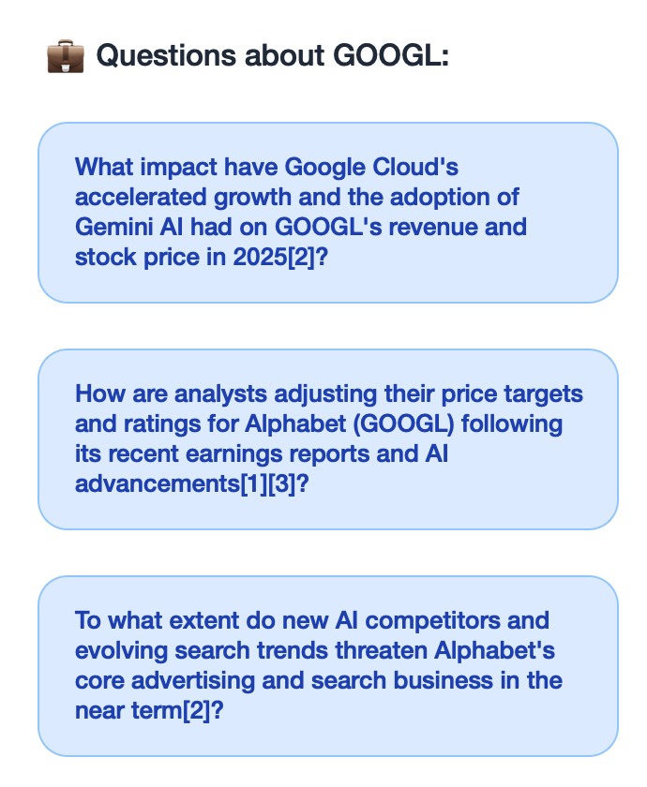
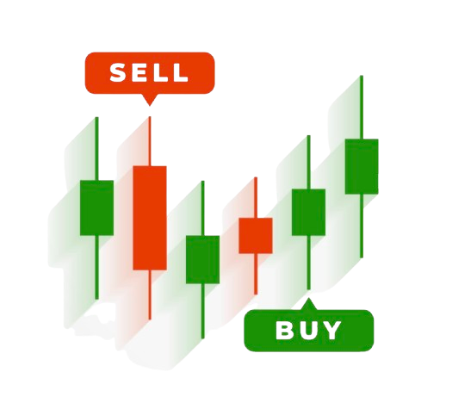
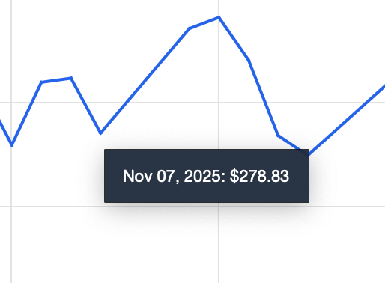
Frontend
AI-Powered Recommendations
Interactive Stock Charts
Market Assistant Panel

Slide 5


Backend
Account Creation and User Info Storage
Secure User Login and Authentication
Historical and live Data Integration
Low-Latency Data Storage (SQL-Based)
Flexible Data Slicing & Filtering
Notes:
- On startup the data is pulled into a SQL db
- Uses Qprocess to run the python files that pull data from the SQL and then the data is parsed into a Qjson object and displayed

Slide 6
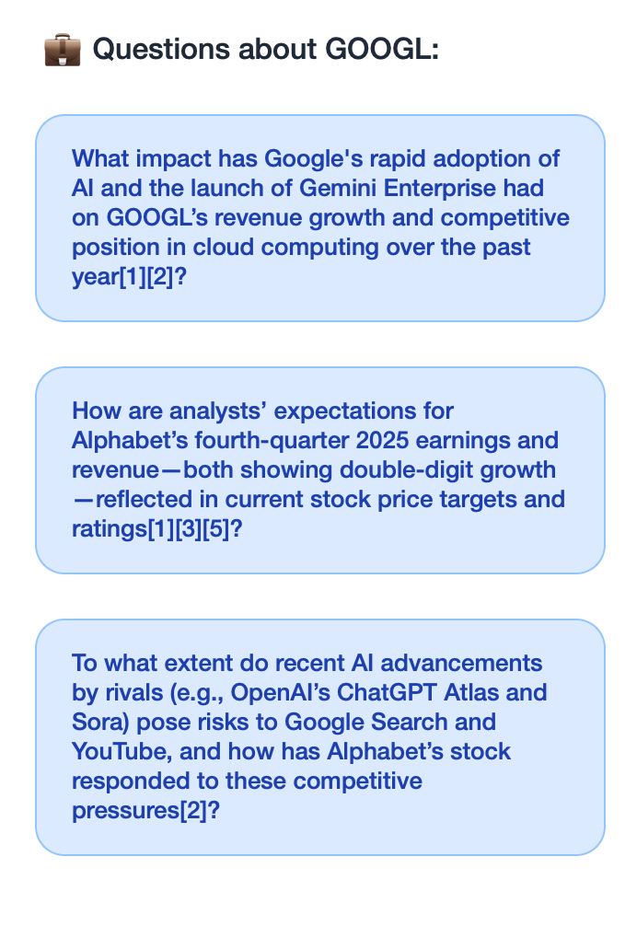
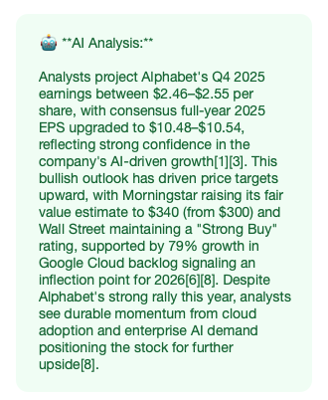
AI Chat
USER SELECTS QUESTION 2
Perplexity AI provides users with a referenced and easy to understand answer
Users can ask predetermined questions via Perplexity AI

Slide 7

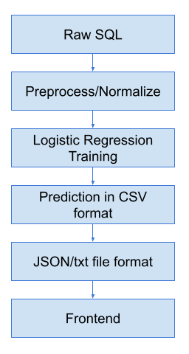
Machine Learning
Raw SQL data preprocessing using SQLite
  Normalizing feature values
  Supervised label generation
Multinomial Logistic Regression Model
  Multiclass classification - Buy, Sell or Hold
  Used model locally, file implementation - not library imports
Outputs stored in csv
  Converted to JSON and text files for frontend access

Slide 8
Demo
Alt Link

Slide 9




System Design
Frontend
  Developed desktop UI using QT for user interaction and visualization
Data Ingestion
  Pulled market data using Yfinance API
  Processed data in Pandas
  Stored structured results into a local SQLite database
AI interaction Layer
  Converts API data into three predefined questions
  User selects question, sent to perplexity, receives in JSON, then to QT
Firebase Authentication
  Implemented secure login + account creation feature

Slide 10
Difficulties
Overcome
Not Overcome
Frontend
  Changed from React to QT to meet 60%+ C++ requirement
Data Ingestion
  Slow API calls
  One call and stored in SQL database
ML Model
  Could not use XG Boost, Cat Boost, or Random Forest Regression Model for the ML due to C++ restrictions
AI Interaction
  Answers too complicated
  Prompted for a simpler output

Slide 11
What We Would Do Differently
Identify a Project Better Suited to C++
Implement a Dynamic Question Feature
Implement an XGBoost or Random Forest Regression Model
Improve Feature Planning Across Sprints
Notes:
Identify a project better suited to C++
Implement a XGBoost or Random Forest Regression Model
Assuming less strict C++ constraints
Implement a dynamic question feature
Improve Feature Planning Across Sprints
Better subdivide features into smaller pieces

Slide 12


Library and Framework Usage
Library usage enabled core functionality across all development stages and functionalities of the project
Local Data Storage
Data Ingestion
API Requests
Application Development

Slide 13
Work Left To Do
Continue training the model
Develop Search Bar
Customization
Bookmarks
Make sources clickable in the Ai Chat

Slide 14
Team Techniques
Consistent Sprint Structure
Version Control Discipline (Git + Branching)
Accurate Deadlines
Pair Debugging Sessions
Standups + Mid-Week Sync
Late Integration of Components

Slide 15
Work Distribution
Feature | Team Member | Time Completed (Approx.)
Data Ingestion | Lucas Hallstrom | Week 8
ML Model | Muhammad Hamza Khan | Week 8
AI Interaction | Duncan Keitzke | Week 7
Frontend + Integration | Kabeer Makkar | Week 10
Authentication | Nicolas Raco | Week 4

Slide 16

Thank you – the team will now take any questions

